Slide 1
CSC 112: Computer Operating Systems Lecture XX Deadlocks
Department of Computer Science,
Hofstra University
Acknowledgement: Lecture slides based on UC Berkeley CS 162: Operating Systems and System Programming

Slide 2
What is a deadlock
Permanent blocking of a set of processes that share multiple resources. Each process in the set is waiting for a resource that only another process in the set can make available
Blocking is caused by processes waiting for resources that are in use by other processes waiting for other resources
e.g., Process A owns Res 1 and is waiting for Res 2 Process B owns Res 2 and is waiting for Res 1
Neither process can proceed, so they are in a deadlock
Process
A
Wait
For
Owned
By
Res 1
Res 2
Owned
By
Wait
For
Process
B
2
Notes:
Process A is using resource 1 and waiting for resource 2; Process B is using resource 2 and waiting for resource 1.
Preemptible resources
Resources that can be taken away from a process without adversely affecting or changing its outcome
Example: memory (swapping)
Can be thought of as reusable resources
These are generally not involved in deadlock
Non-Preemptable resources
Cannot be taken away from the present user without causing the process to fail (includes producing inconsistent output or race condition).
For example writing output to CD or printer. Taking the resource away and giving it to someone else produces unusable outputs
Must protect the resource (mutual exclusion)
Requesting process may be forced to wait or rerequest the resource later
Sharing these resources may lead to deadlock

Slide 3
Starvation vs Deadlock
Starvation: thread waits indefinitely
Example, low-priority process waiting for resources constantly in use by high-priority process
Deadlock: circular dependency waiting for resources
Deadlock ⇒ Starvation but not vice versa
Starvation can end (but doesn’t have to)
Deadlock can’t end without external intervention
Notes:
Starvation vs. Deadlock
Starvation: thread waits indefinitely
Deadlock: circular waiting for resources

Slide 4
Bridge Crossing Analogy
Each segment of road can be viewed as a resource
Car must own the segment under them
Must acquire segment that they are moving into
For bridge: must acquire both halves
Traffic only in one direction at a time
Problem occurs when two cars in opposite directions on bridge: each acquires one segment and needs next
If a deadlock occurs, it can be resolved if one car backs up (preempt resources and rollback)
Several cars may have to be backed up
Starvation is possible
Heavy traffic going east ⇒ no car can go west
Honk!

Slide 5
Train Example (Wormhole-Routing for NoC)
Circular dependency (Deadlock!)
Each train wants to turn right, but blocked by other trains
Similar problems occur for Network-on-Chip
One solution:
Force ordering of channels (fixed global order on resource requests)
Protocol: Always go horizontal (east-west) first, then vertical (north-south)
Called “dimension ordering” (X then Y)
Disallowed
By Rule

Slide 6
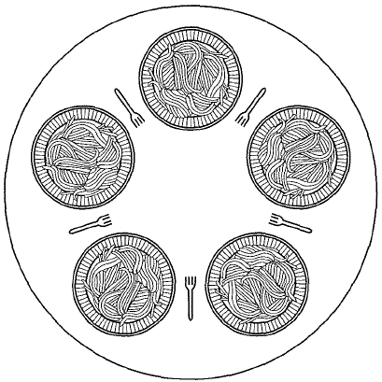
Dining philosophers
5 forks/5 philosophers
Need two forks to eat
What if all grab left fork at same time?
Deadlock!
How to fix deadlock?
Make one of them give up a fork
Eventually everyone will get chance to eat
How to prevent deadlock?
Never let philosopher take last fork if no hungry philosopher has two forks afterwards
DINING-PHILOSOPHERS PROBLEM: SIMPLIFIED
https://www.youtube.com/watch?v=VSkvwzqo-Pk
Notes:
Philosopher will grab any one they can

Slide 7
Necessary conditions for deadlock
Mutual exclusion
Only one process at a time can use a resource.
Hold and wait
Process holding at least one resource is waiting to acquire additional resources held by other processes.
No preemption
Resource cannot be forcibly removed from a process; can be released only voluntarily by the process.
Circular wait
A circle of processes exists such that each process holds at least one resource needed by the previous process in the circle
Notes:
Four conditions for deadlock
Mutual exclusion
Only one process at a time can use a resource
Hold and wait
Process holding at least one resource is waiting to acquire additional resources held by other processes
No preemption
Resources are released only voluntarily by the processes
Circular wait
Cyclic waiting pattern

Slide 8
Deadlock handing
Deadlock prevention
Make sure one of the conditions necessary to create a deadlock cannot be present in the system
Deadlock detection
Resource Allocation Graph (cannot handle multi-instance resources well)
Banker’s algorithm for detecting (potential) deadlocks
Deadlock recovery
Let deadlock happen
Monitor the system state periodically to detect when deadlock occurs
Take action to break the deadlock

Slide 9
Deadlock Prevention Techniques
Break “mutual exclusion” by spooling resources
Break “hold and wait” condition: Make all processes request everything they’ll need at the beginning.
Problem: Predicting future is hard, tend to over-estimate resources
Example:
If need 2 forks, request both at same time (our solution to dining philosopher problem)
Break “circular wait” condition:
Force all processes to request resources in a particular order to prevent cyclic use of resources. Example:
Request disk, then memory, then…
Recall: simple solution to dining philosopher problem
May not be practical, since runtime resource usage pattern is generally unknown
Banker’s algorithm can prevent future “circular wait” conditions by detecting potential deadlocks
Break “no preemption” condition:
Deadlock recovery techniques discussed later
Condition | Approach
Mutual exclusion | Spooling
Hold and wait | request all resources initially
Circular wait | Request resources in a particular order
No preemption | Take resources away
Notes:
Figure 6-14. Summary of approaches to deadlock prevention.

Slide 10
Spooling
A single daemon process directly uses the resource; other processes send their requests to the daemon, e.g.:
The resource is no longer directly shared by multiple processes
Proc 1
Printing
Daemon
Printer
Proc 2

Slide 11
Request all resources initially
Disallow hold-and-wait
Make each process request all resources at the same time and block until all resources are available to be granted simultaneously
One solution to Dining Philosopher problem
May be inefficient
Process may have to wait a long time to get all its resources when it could have proceeded and completed a significant portion of it work with the resouces that were already available
Resources allocated to a process may remain unused for long periods of time blocking other processes
Processes may not know all resources they will require in advance.
Notes:
How do we prevent deadlock from happening under any circumstances within our application?
Direct prevention: Design to avoid deadlock (no circular waits possible)
Indirect prevention: prevent the occurrence of one of the necessary conditions
Generally need mutual exclusion so that is not a good candidate to disallow

Slide 12
Order resources numerically
Prevent circular wait
Define a total order of resources; If a process holds certain resources, it can subsequently request only resources that follow the types of held resources in the total order.
This prevents a process from requesting a resource that might cause a circular wait.
if process L has resource 1 and process J has resource 3, the process L can request resource 3, but process J cannot request resource I and cause deadlock
Another solution to Dining Philosopher’s problem
Introduces inefficiencies and can deny resources unnecessarily.
Notes:
May be impossible to re-request the same resource

Slide 13
Example with deadlock
semaphore res1, res2;
void procA( ) {
semWait(&res1);
semWait(&res2);
useBothRes( );
semSignal(&res2);
semSignal(&res1);
}
void procB( ) {
semWait(&res2);
semWait(&res1);
useBothRes( );
semSignal(&res1);
semSignal(&res2);
}

Slide 14
Example: no deadlock (Order resources numerically)
semaphore res1, res2;
void procA( ) {
semWait(&res1);
semWait(&res2);
useBothRes( );
semSignal(&res2);
semSignal(&res1);
}
void procB( ) {
semWait(&res1);
semWait(&res2);
useBothRes( );
semSignal(&res2);
semSignal(&res1);
}

Slide 15
Take resources away
Allow preemption. Can be implemented different ways
If a process holding a resource is denied another resource and forced to wait, it must relinquish the resource it is holding and request it again (if needed) when the blocked resource is available
If a process requests a resource that is in use (usually by a lower priority process), the process using the resource will be preempted and the resource will be supplied to the requesting process.
Requires additional OS complexity
Mainly used for deadlock recovery, not prevention (more later)

Slide 16
Ostrich algorithm
Ignore the possibility of deadlock, maybe it won’t happen
In some situations this may even be reasonable, but not in all
If a deadlock in a process will happen only once in 100 years of continuous operation we may not want to make changes that will likely decrease efficiency to avoid that rare event.
Events will occur randomly, we don’t know that the 1 in 100 years will not occur in 1 second. If a deadlock in a process will happen on average once per minute, we probably want to do something other than implement the ostrich algorithm and ignore it
In mission critical applications, the ostrich algorithm approach is inappropriate if a catastrophic failure may result from a deadlock
Notes:
https://tenor.com/en-GB/search/ostrich-head-in-sand-gifs

Slide 17
Resource-allocation graph (RAG)
System Model
A set of Processes P₁, P₂, . . ., P_{n}
Resource types R₁, R₂, . . ., R_{m}
CPU cycles, memory space, I/O devices
Each resource type R_{i} has W_{i} instances.
Each thread utilizes a resource as follows:
Request() / Use() / Release()
Resource-Allocation Graph (RAG):
V is partitioned into two types:
P = {P₁, P₂, …, P_{n}}, set of processes in the system.
R = {R₁, R₂, …, R_{m}}, set of resource types in system
request edge – directed edge P₁ → R_{j}
assignment edge – directed edge R_{j} → P_{i}
Symbols
P₁
P₂
R₁
R₂

Slide 18
RAG for deadlock detection
For any given sequence of requests for and releases of resources a RAG can be constructed
We check the graph
no cycle → no deadlock
Each resource has a single instance AND cycle → deadlock (necessary and sufficient)
Each resource has multiple instances AND cycle → maybe deadlock (but not sufficient condition)
Need Banker’s algorithm to detect deadlocks
R2
Resource 2 requested by process 2
P1
P2
R1
Resource 1 held by process 2
A RAG with a deadlock
Notes:
deadlock IMPLIES cycle (necessary condition)

Slide 19
Example
Consider 3 processes A, B and C scheduled using round-robin algorithm
A requests R
A
B
C
R
S
T

Slide 20
Example
A requests R
A holds R
A
B
C
R
S
T

Slide 21
Example
A requests R
A holds R
C requests T
C holds T
A
B
C
R
S
T

Slide 22
Example
A requests R
A holds R
C requests T
C holds T
B requests S
B holds S
A
B
C
R
S
T

Slide 23
Example
A requests R
A holds R
C requests T
C holds T
B requests S
B holds S
B requests R
A
B
C
R
S
T

Slide 24
Example
A requests R
A holds R
C requests T
C holds T
B requests S
B holds S
B requests R
C requests S
A
B
C
R
S
T

Slide 25
Example: cycle (deadlock)
A requests R
A holds R
C requests T
C holds T
B requests S
B holds S
B requests R
C requests S
A requests T
A
B
C
R
S
T

Slide 26
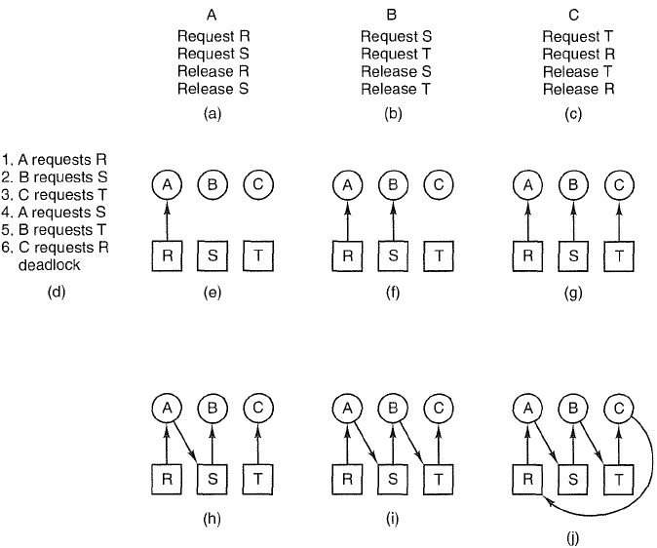
Another example with deadlock

Slide 27
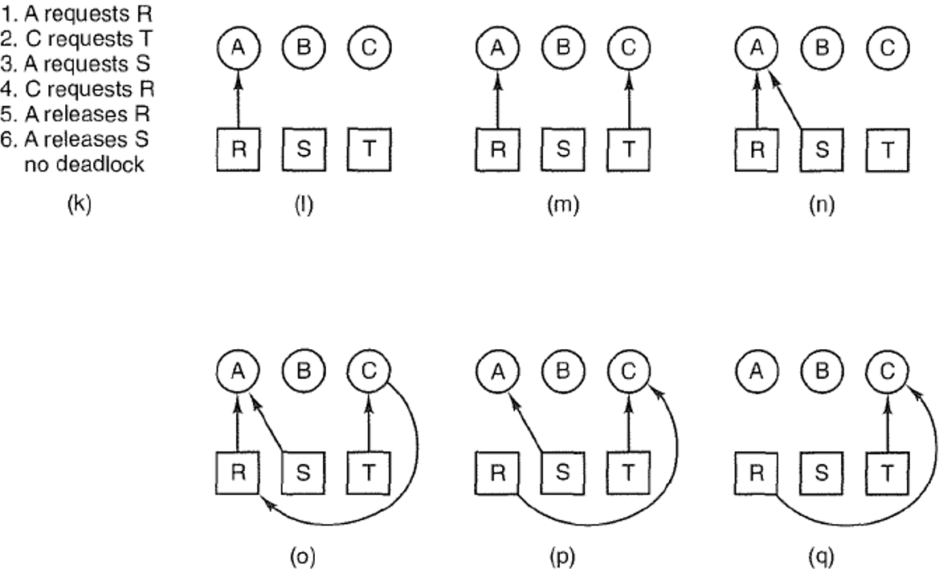
Deadlock is avoided by delaying B’s request
Notes:
Figure 6-4. An example of how deadlock occurs and how it can be avoided.

Slide 28
Resource Allocation Graph Examples
R₁
R₂
R₁
R₂
R₁
T₂
T₁
T₂
T₃
T₁
T₂
T₃
T₁
T₃
R₃
T₄
R₄
R₃
R₂
R₄
No Cycle;
No Deadlock
Deadlock (cycle R₃->T₂->R₂->T₃
And cycle R₃->T₁->R₁->T₂->R₂->T₃
Cycle,
but No Deadlock
(T₂ or T₄ may release
res later)
Notes:
Animation: http://cs.uttyler.edu/Faculty/Rainwater/COSC3355/Animations/deadlock.htm

Slide 29
Banker’s algorithm for deadlock detection
To avoid deadlocks we need to be able to detect them, preferably before they occur.
RAG can only detect deadlocks reliably for the case of single-instance resources.
Banker’s algorithm is more general and can deal with multiple-instance resources. It is used to recognize when it is safe to allocate resources
Analyze the state of the system; If the state is unsafe, take actions to break actual or potential deadlocks and bring the system back to a safe state
Do not grant additional resources to a process if this allocation might lead to a deadlock

Slide 30
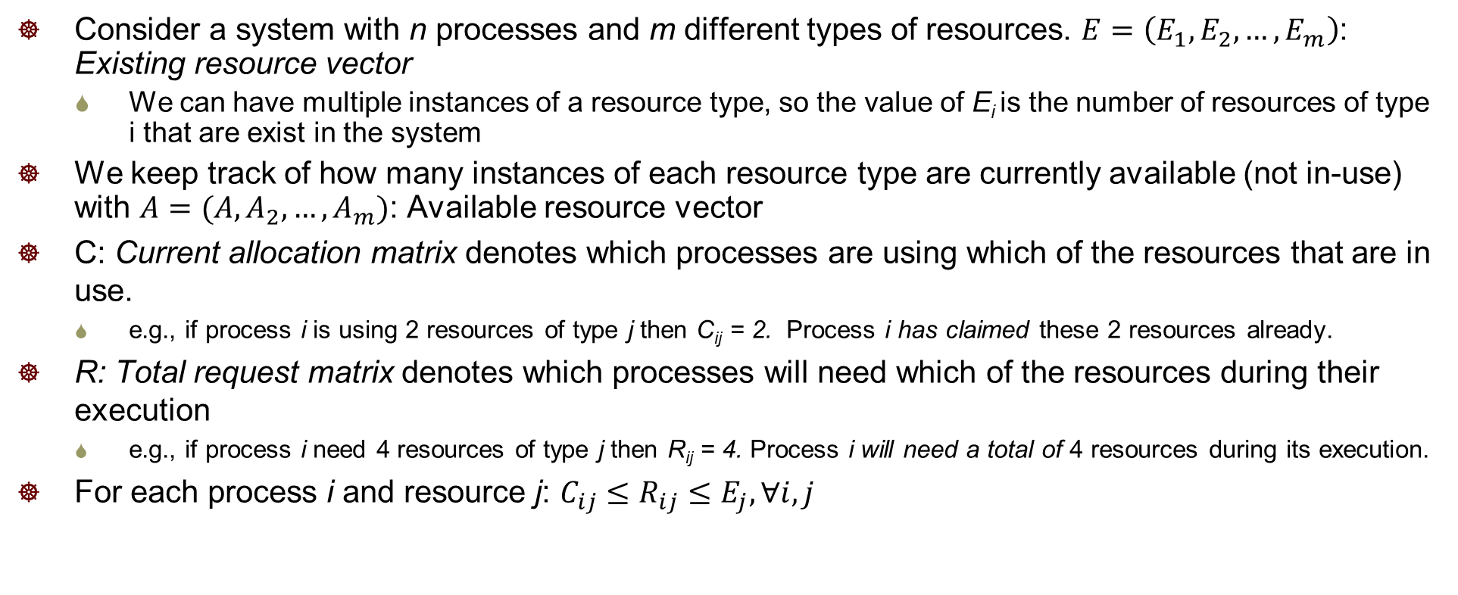
Problem Definition
Consider a system with n processes and m different types of resources. $E=\left(E_{1},E_{2}, …, E_{m}\right)$: Existing resource vector
We can have multiple instances of a resource type, so the value of E_{i} is the number of resources of type i that are exist in the system
We keep track of how many instances of each resource type are currently available (not in-use) with $A=(A,A_{2}, …, A_{m})$: Available resource vector
C: Current allocation matrix denotes which processes are using which of the resources that are in use.
e.g., if process i is using 2 resources of type j then C_{ij} = 2. Process i has claimed these 2 resources already.
R: Total request matrix denotes which processes will need which of the resources during their execution
e.g., if process i need 4 resources of type j then R_{ij} = 4. Process i will need a total of 4 resources during its execution.
For each process i and resource j: $C_{ij}≤R_{ij}≤E_{j},∀i, j$
Notes:
Every resource is either allocated or available
Process i will need these 4 resource
No process can claim more than the total amount of resources in the system; No process is allocated more resources of any type than the process originally claimed to need

Slide 31
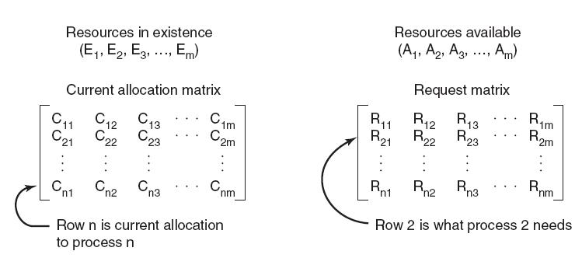
Four data structures encode current state of the system
Total
Notes:
Figure 6-6. The four data structures
Define the state of a process to be a list of the number of resources of each available type presently allocated to it, and the maximum number of resources of each type it will need simultaneously
The state of the system is an aggregate of the states of all the processes in the system along with the number of available and allocated resources of each type, encoded in the following:
E (Existing resource vector)
A (Available resource vector)
R (Total Request matrix)
C (Current allocation matrix)

Slide 32
Safe states and unsafe states
The state of the system can be either safe or unsafe
A safe state is a state in which there exists at least one sequence of resource allocations that will allow all processes in the system to complete without deadlock
An unsafe state is a state in which there exists no sequence of resource allocation that will complete all processes in the system without deadlock
Each time a resource is requested, determine the state of the system after the resource is allocated, and if that state is safe or unsafe (will potentially deadlock). If the state will be unsafe we block the process and do not allocate the requested resources (to avoid potential deadlock)

Slide 33
Bankers algorithm: preliminaries
Compute R-C: Resources needed matrix
To determine if a process i can run to completion, we need to compare two vectors:
(R-C)_{i}: row i in the matrix R-C of unmet resource needs
A: available resources vector A
(R-C)_{i} <= A if (R_{ij} –C_{ij}) <= A_{j} for all resource type j

Slide 34
Banker’s algorithm
Algorithm CheckSafety() for checking to see if a state is safe:
Compute resources needed R-C
ook for a process i that can run to completion by finding an unmarked row i with (R-C)_{i} ≤ A. If no such row exists, system will eventually deadlock since no process can run to completion
Assume process of row i requests all resources it needs and finishes. Mark process i as completed, free all its resources and add the i-th row of C to the A vector
Repeat steps 1 and 2 until either all processes marked terminated (initial state is safe) or no process is left whose resource needs can be met (there is a deadlock, so initial state is unsafe).
Notes:
Look for an unmarked process, P_{i} , for which the i-th row of R is less than or equal to A.
If such a process is found, add the i-th row of C to A, mark the process as completed, and go back to step 1.
If no such process exists, the algorithm terminates.
If (R_{Lk} –C_{Lk}) ≤ A_{k} for all k)

Slide 35
Banker’s algorithm cont’
When a process makes a request for one or more resources:
Update the state of the system assuming the requests are granted.
Determine if the resulting state is a safe state by calling CheckSafety()
If so grant the request for resources.
Otherwise, block the process request until it is safe to grant it.

Slide 36
An example system: starting state
4 processes P1 through P4; 4 resource types with 10, 5, 6, 5 instances each.
Current system state encoded in matrices R, C and vectors E, A.
Total request matrix
Current allocation matrix
Resources in existence
Resources available
A is obtained by subtracting each column sum of C from E
10-(1+5+2+0)=2, 5-(0+1+1+0)=3
6-(0+1+1+2)=2, 5-(0+1+0+0)=4
Notes:
Resources in existence
Resources available
(E1, E2, E3, ..., Em)
(A1, A2, A3, ..., Am)
Total Request matrix
Current allocation matrix

Slide 37
Request to check for safety
Assume the starting state is a safe state (can be checked with Banker’s algorithm)
P2 is now requesting 2 more of Resource 1 and 1 more of Resource 3
Do we grant this request? Might this request cause deadlock?
Step 1: Calculate the state of the system if this request is filled
Step 2: determine if the new state is a safe state with Bankers algorithm

Slide 38
An example system: new state
Total request matrix
Current allocation matrix
Resources needed matrix
Resources in existence
Resources available
A is obtained by subtracting each column sum of C from E
10-(1+7+2+0)=0, 5-(0+1+1+0)=3
6-(0+2+1+2)=1, 5-(0+1+0+0)=4

Slide 39
An example: is new state safe
Check row 1 of matrix R-C
(R-C)₁ = [2, 2, 2, 1] > A
P1 cannot run to completion

Slide 40
An example: is new state safe
Check row 2 of matrix R-C
(R-C)₂ = [0, 0, 1, 0] <= A
Allocate resources and run P2 to completion;
Free all its resources and add them to A:
A=[0 3 1 4]+[7 1 2 1] = [7 4 3 5]

Slide 41
An example: is new state safe
Row 2 process marked as completed
Check row 1 of matrix R-C again
(R-C)₁ = [2, 2, 2, 1] <= A
Allocate resources and run P1 to completion;
Free all its resources and add them to A:
A = [7 4 3 5] + [1 0 0 0]=[8 4 3 5]

Slide 42
An example: is new state safe
Check row 3 of matrix R-C
(R-C)₃ = [1, 0, 3, 0] <= A
Allocate resources and run P3 to completion;
Free all its resources and add them to A:
A = [8 4 3 5] + [2 1 1 0] = [10 5 4 5]

Slide 43
An example: is new state safe
Check row 4 of matrix R-C
(R-C)₄ = [4, 2, 0, 1] <= A
Allocate resources and run P4 to completion
Free all its resources and add them to A:
A = [10 5 4 5] + [0 0 2 0] = [10 5 6 5]

Slide 44
An example: is new state safe
Now:
All process can complete successfully. Therefore, the starting state is a safe state
Allocate the requested resources (2 more of resource 1 and 1 more of resource 3) to P2, and proceed with execution of all processes
Notes:
Process 2 is now requesting 2 more of resource 1 and 1 more of resource 3

Slide 45
Next Request to Check for Safety
Now start from this new safe state, and consider the next request for resources
Process 1 is now requesting 1 more of resource 3
Do we grant this request? Might this request cause deadlock?
Step 1: Calculate the state of the system if this request is filled
Step 2: Determine if the new state is a safe state, use the bankers algorithm

Slide 46
New starting state: next request Is this state safe?
Check all rows
(R-C)₁ = [2, 2, 1, 1] (R-C)₁ > A
(R-C)₂ = [0, 0, 1, 0] (R-C)₂ > A
(R-C)₃ = [1, 0, 3, 0] (R-C)₃ > A
(R-C)₄ = [4, 2, 1, 0] (R-C)₄ > A
No process can run to completion. The state is unsafe, as processes may be deadlocked

Slide 47
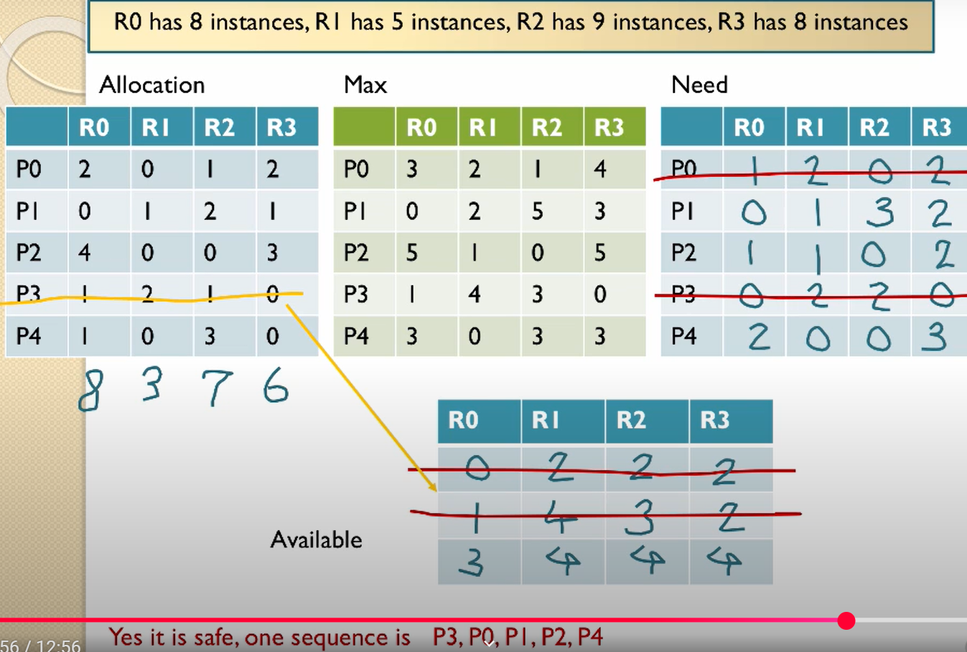
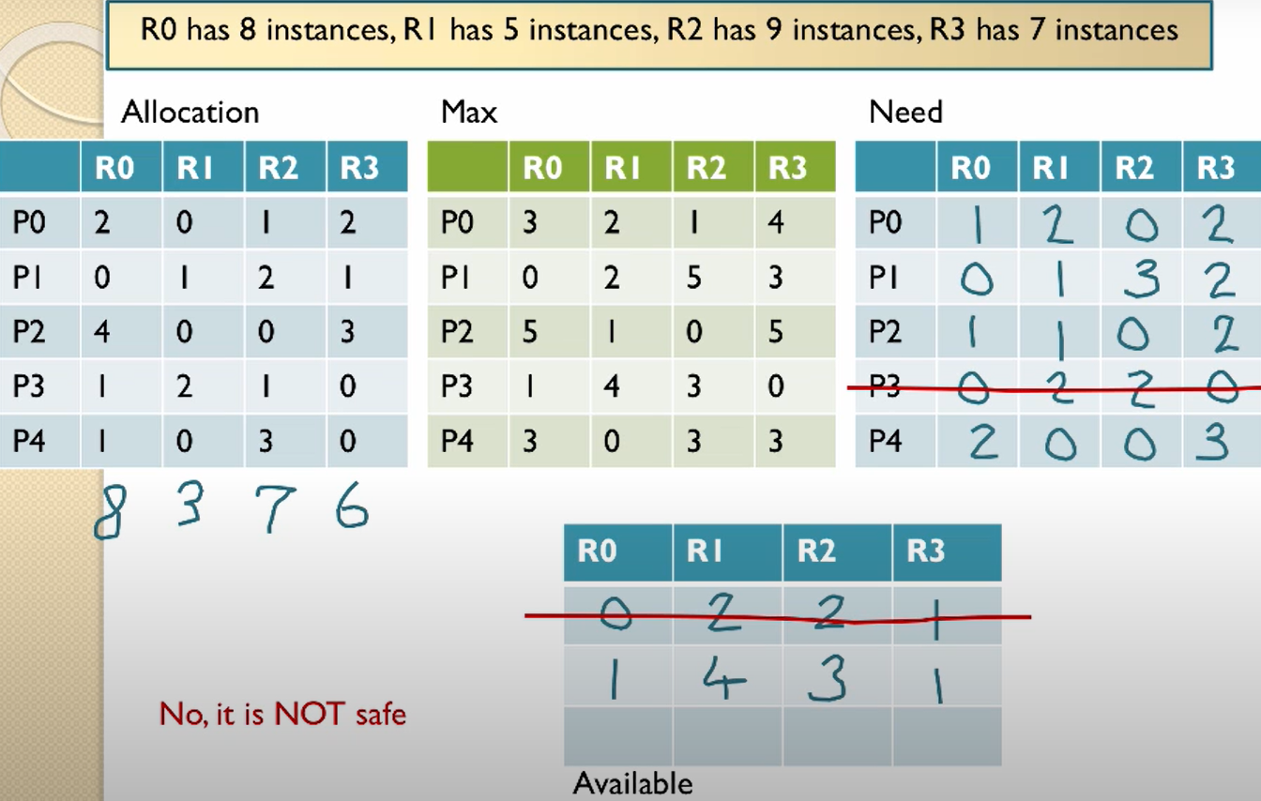
Video tutorial of Bankers algorithm
Deadlock avoidance: https://www.youtube.com/watch?v=AvPjOyeJbBM

Slide 48
Unsafe state vs. deadlock
The unsafe state indicates not that the system is deadlocked or will become deadlocked, but that there is potential for deadlock if the system operates in that state. Thus, to avoid deadlock, we do not allow the system to allocate resources that would put it into an unsafe state.
This is a conservative strategy. It is possible that processes blocked because of a risk of deadlock would not in fact cause a deadlock during execution
We are basing deadlock detection on worst case assumptions
The process may use ALL the resources it needs at any time

Slide 49
Banker’s algo applied to Dinning Philosophers
State is safe if when a philosopher tries to take a fork, either
It is not the last fork,
Or it is the last fork, but someone will have 2 forks afterwards.
Equivalently: do not let a philosopher take the last fork if no one will have 2 forks afterwards.
Consider N philosophers
If each of the N-1 philosophers holds his left fork, then the N^{th} philosopher will be prevented from taking the last fork.
If a philosopher is holding his left fork, he can safely pick up his right fork if available, and vice versa.
If one or more philosophers are holding 2 forks and eating, then any remaining forks can be picked up safely by any other philosopher.
Banker’s algorithm can be used to verify each of these scenarios

Slide 50
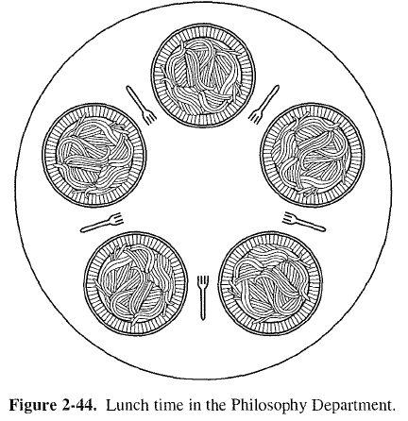
Banker’s algo applied to Dinning Philosophers cont’
Model each fork as a separate resource, since each philosopher can only pick up his left and right forks.
Suppose we have 5 philosophers numbered 1-5, and 5 forks numbered 1-5; philosopher i has left fork numbered i, and right fork (i+1)%5.
4
5
4
5
3
1
3
1
2
2

Slide 51
When 4 philosophers each holds his left fork
Total Request matrix
Current allocation matrix
Resources in existence
Resources available
Philosophers 1-4 each is holding his left fork. If the 5th philosopher makes a request for his left fork, should we grant it?

Slide 52
The deadlocked state when each holds his left fork
Total Request matrix
Current allocation matrix
Resources in existence
Resources available
No. Here is the deadlock state reached if the request is granted.

Slide 53
Minimum Resource Constraint
In all our problem formulations, we have assumed there are a minimum number of resources to allow at least one process to finish. Without this constraint, the system cannot even start execution, hence the problem is ill-defined.
Consider the dining philosophers problem with a single fork, or no fork available.

Slide 54
When to run Banker’s algorithm?
Run it each time a resource allocation request is made. This can be expensive.
Run it periodically driven by a timer interrupt. A longer period between checks gives
Higher efficiency due to less calculation involved in the checking
Undetected deadlocks can persist for longer times
What to do if an actual deadlock is detected?
Notes:
When a periodic system check is done
The state of the system is determined
Banker’s algorithm is run
Then either
System is in a safe state: no deadlock
System is in an unsafe safe state: maybe deadlocked

Slide 55
Deadlock recovery
Abort all deadlocked processes:
most common solution implemented in OSs.
Rollback:
Back up each process periodically.
in case of deadlock roll back to the previous backup (checkpoint).
It is possible the deadlock may reoccur.
Usually the deadlock will not reoccur due to the nondeterministic nature of the execution of concurrent processes (there may be a different interleaving of instruction executions the next time).

Slide 56
Deadlock recovery: 2
Successively abort deadlocked processes.
Abort 1 deadlocked process at a time.
Then check if the deadlock still occurs
If it does abort the next process.
If it does not, continue execution of the remaining processes without aborting any more processes.
Successively preempt resources from blocked jobs
Preempt 1 deadlocked resource in 1 process.
Roll back that process to the point where the preempted resource was allocated.
Check if deadlock still occurs
If it does preempt resource from the next process.
If it does not, continue execution of the remaining processes without preempting any more resources.

Slide 57
Choosing processes/resources
For options 3 and 4 it is necessary to choose which of the possibly deadlocked processes to abort or which resource to preempt (and the possibly deadlocked process to preempt it from)
Can base this decision on a number of different criteria
Lowest priority
Most estimated run time remaining
Least number of total resources allocated
Smallest amount of CPU consumed so for

Slide 58
Issues
None of these approaches is appropriate for all types of resources
Some processes (like updating a database) cannot be killed and rerun safely.
Some resources cannot be safely preempted (some of these like printers can be preempted if spooling is used).
Some processes cannot be rolled back.
How do you roll back shared variables that have been successively updated by multiple processes.
Process rollback is expensive.
Successive checkpoints must save both image and state.
Multiple checkpoints need to be saved for a process.

Slide 59
Communication Deadlocks
Process A sends a request message to process B, and then blocks until B sends back a reply message.
Suppose that the request message gets lost. A is blocked waiting for the reply. B is blocked waiting for a request asking it to do something. Deadlocked.
Deadlock not due to shared resources.

Slide 60
Summary of Banker’s algorithm
Look one step ahead: upon receiving a request from a process, assume the request is granted hypothetically, run deadlock detection algorithm to evaluate if the system is in a safe state.
A state is safe if from this state, there exists a sequence of process executions {P₁, P₂, … P_{n}} with P₁ requesting all remaining resources, finishing, then T₂ requesting all remaining resources, etc..that can finish successfully.
Grant the request if next state is safe.
Algorithm allocates resources dynamically, and allows the sum of maximum resource needs of all current processes to be greater than total resources
It is a conservative algorithm, since each process must declare the maximum resource requests, which may be a pessimistic estimate of the actual resource requests at runtime.
Notes:
Technique: pretend each request is granted, then run deadlock detection algorithm, ([R_{i}]-[C_{i}] ≤ [A]) Grant request if result is deadlock free (conservative!)
Evaluate requests from each process, and grant all its requests if feasible
Toward right idea:
State maximum resource needs in advance
Allow particular thread to proceed if:
(available resources - #requested) ≥ max remaining that might be needed by any thread

Slide 61

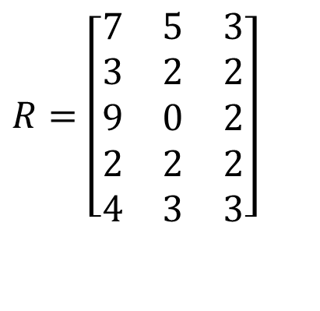

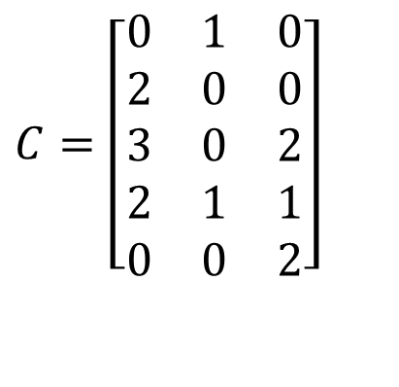
Quiz: Banker’s algorithm
4 processes P0 through P4; 4 resource types with 10, 5, 6, 5 instances each.
Current system state encoded in matrices R, C and vector E.
Total Request matrix
Current allocation matrix
$$R=\left[\begin{matrix}7 & 5 & 3 \\ 3 & 2 & 2 \\ 9 & 0 & 2 \\ 2 & 2 & 2 \\ 4 & 3 & 3\end{matrix}\right]$$
$$C=\left[\begin{matrix}0 & 1 & 0 \\ 2 & 0 & 0 \\ 3 & 0 & 2 \\ 2 & 1 & 1 \\ 0 & 0 & 2\end{matrix}\right]$$
Resources in existence
Resources available
$$E=\left[\begin{matrix}10 & 5 & 7\end{matrix}\right]$$
$$A=\left[\begin{matrix}3 & 3 & 2\end{matrix}\right]$$

Slide 62

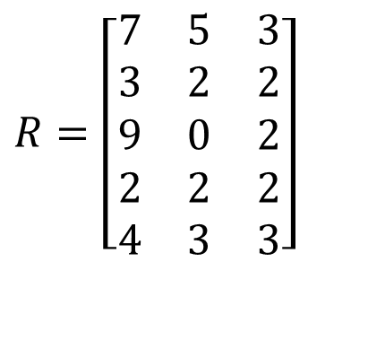
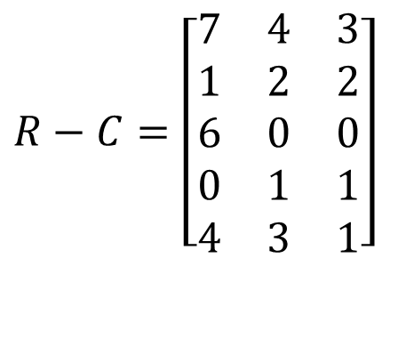

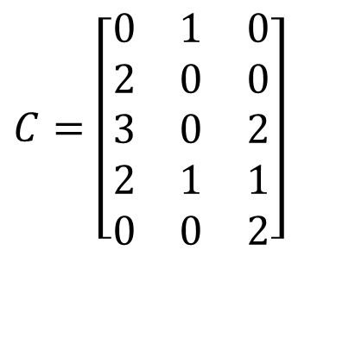
Quiz Solution: Banker’s algorithm
First compute the Resources needed matrix R-C and Resources available vector A.
We can verify that the system is in a safe state, with a possible feasible execution sequence P2, P4, P5, P3, P1.
(R-C)₂ = [1, 2, 2] <= A = [3, 3, 2]. Run P2 to completion and free its resources. Now A = [3, 3, 2] + [3, 2, 2] = [6, 5, 4]
(R-C)₄ = [6, 0, 0] <= A = [6, 5, 4]. Run P4 to completion and free its resources. Now A = [6, 5, 4] + [2, 2, 2] = [8, 7, 6] (We can also run P4 before P2.)
We can run the remaining processes P5, P3, P1 in any order since the available resources are enough to satisfy each process’s needed resources.
Total Request matrix
Current allocation matrix
Resources needed matrix
$$R=\left[\begin{matrix}7 & 5 & 3 \\ 3 & 2 & 2 \\ 9 & 0 & 2 \\ 2 & 2 & 2 \\ 4 & 3 & 3\end{matrix}\right]$$
$$C=\left[\begin{matrix}0 & 1 & 0 \\ 2 & 0 & 0 \\ 3 & 0 & 2 \\ 2 & 1 & 1 \\ 0 & 0 & 2\end{matrix}\right]$$
$$R−C=\left[\begin{matrix}7 & 4 & 3 \\ 1 & 2 & 2 \\ 6 & 0 & 0 \\ 0 & 1 & 1 \\ 4 & 3 & 1\end{matrix}\right]$$
Resources in existence
Resources available
$$E=\left[\begin{matrix}10 & 5 & 7\end{matrix}\right]$$
$$A=\left[\begin{matrix}3 & 3 & 2\end{matrix}\right]$$

